Slide 1


Practical Investigation into Safe Reinforcement
Learning with Autonomous Drive
Tao Sun
^{04/29/2020}

Slide 2
Background
State of the Art Methods
Implementation and Results
Summary

Slide 3
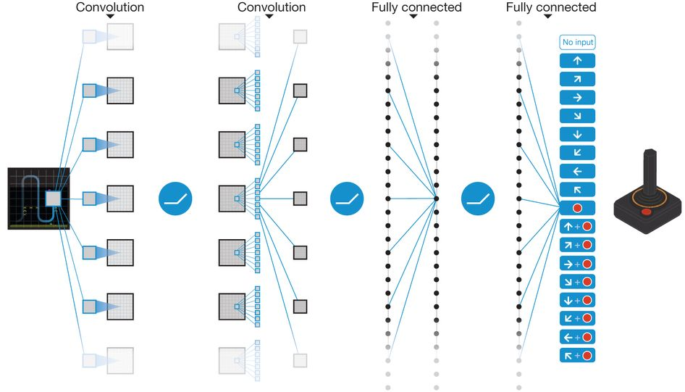
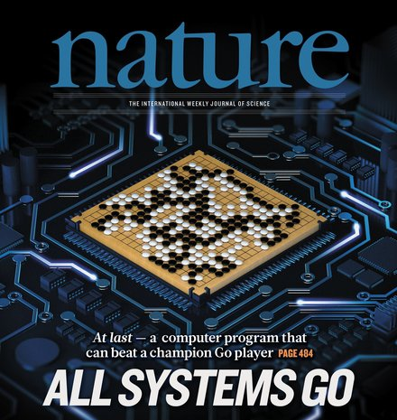
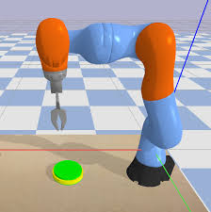
Background – Reinforcement Learning (RL)
Reinforcement Learning at Deep Learning Age
Popular in Atari Games, Go Games, Robotics, etc
Still Limited Practice in Safety-Critical Applications
Autonomous Drive, Datacenter Cooling, etc
Unsafe exploration at the initial stage of RL algorithms
Serious outcomes might be (e.g. car accidents)
Mnih et al. Nature, 2015 Silver et al. Nature, 2016 Kober et al. IJRR, 2013

Slide 4
State of the Art – Safe Reinforcement Learning
Safe Model-based RL [Berkenkamp et al. NIPS, 2017]
Theoretical results for stability guarantee based on Lyapunov function
Need prior knowledge about the physical system (model-based)
Required Lipschitz continuity conditions might not always true
Constrained Policy Optimization [Achiam et al. ICML, 2017]
Update the policy with a trust-region policy gradient method
In each iteration projects the policy to a safe feasibility set
Meet safety constraints in expectation
Safe Exploration in Continuous Action Spaces [Dalal et al. 2018] (for this project)
Propose a linearly approximated Safety Layer to predict the “safety signal”
Closed form solution and simple implementation
Tested on simple games and achieved zero safety violations

Slide 5
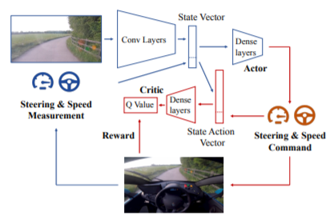
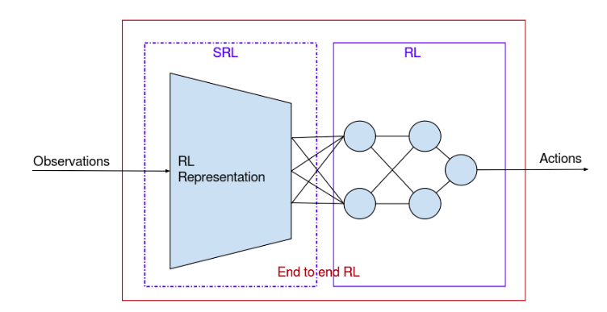
State of the Art – Autonomous Drive using RL
Learning to Drive in A Day [Kendall et al. 2018]
First end-to-end application of deep RL in autonomous drive
Variational auto-encoder (VAE) to extract the image features → fast training
Practical implementation with Donkey Car simulator [Raffin & Sokolkov, github, 2019]

Slide 6
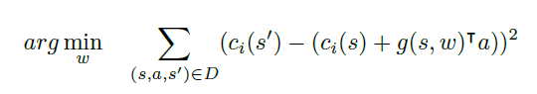
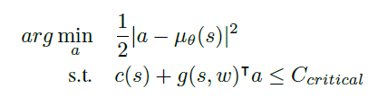
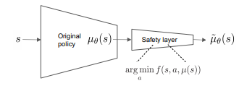
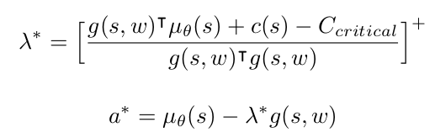
State of the Art – Safety Layer method
Safe Exploration in Continuous Action Spaces [Dalal et al. 2018]
Linear approximation to describe the safety signal with a neural network g(s,w)
Revise the proposed action not to violate the safety constraint
Close form solution available

Slide 7
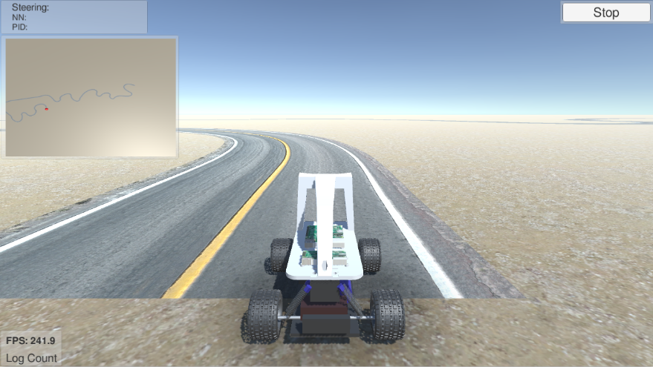

Implementation – Case One with Simple Environment
Case One: Simple Environment
Most of the lane is straight, with very infrequent smooth turns
Safety signal (the car’s max deviation off the lane) information collected by random sampling and running partially trained model
The linearly approximated safety layer trained with two fully connected layers, with 64 and 16 neurons respectively
Lane Environment Front Camera Image

Slide 8
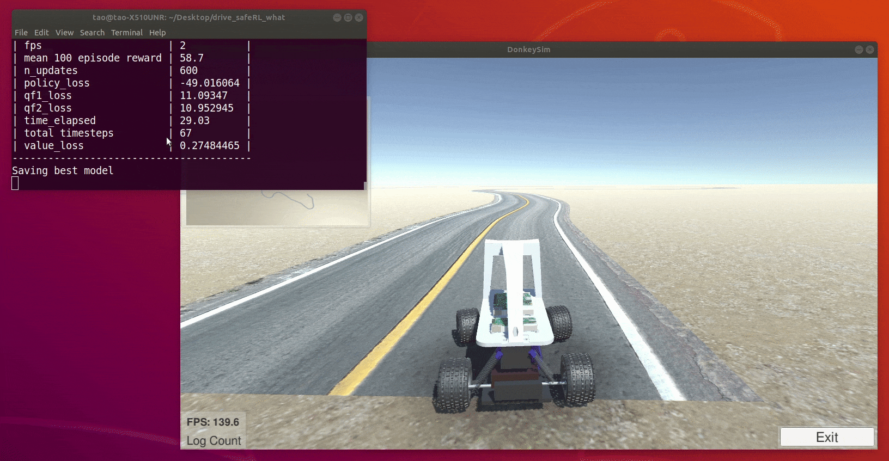
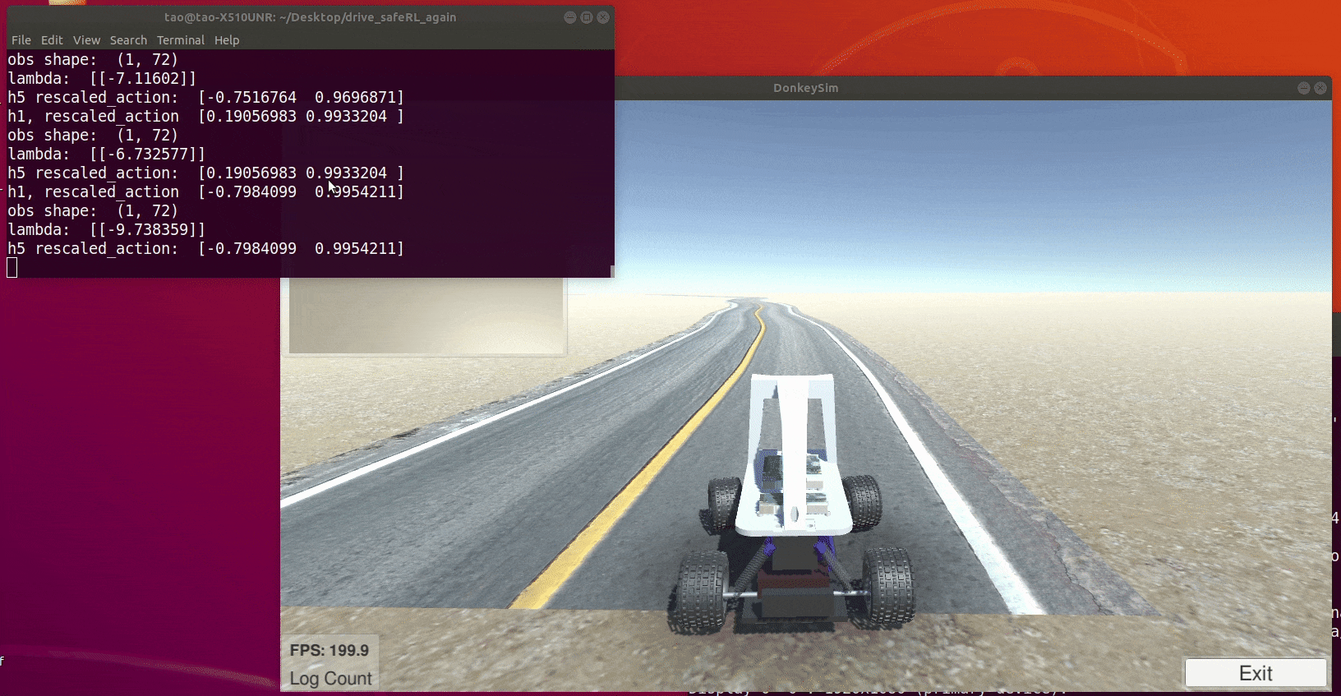
Implementation – Case One with Simple Environment
Case One: Results – Gif Images
The safety layer would push the car back to the lane when it is about to violate the boundary, thus safety is ensured
Without Safety Layer With Safety Layer

Slide 9
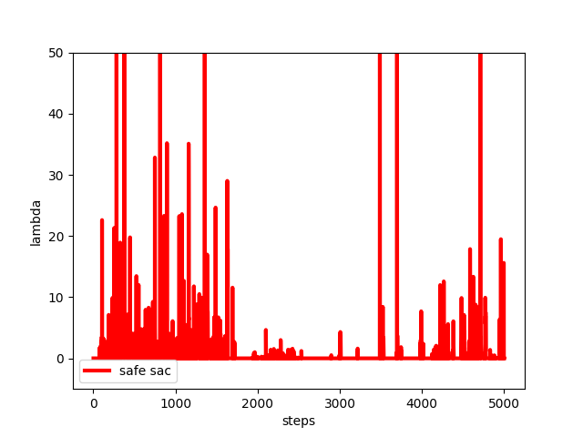
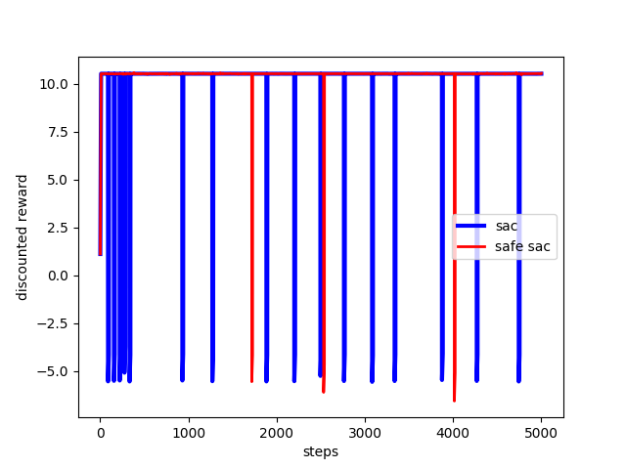
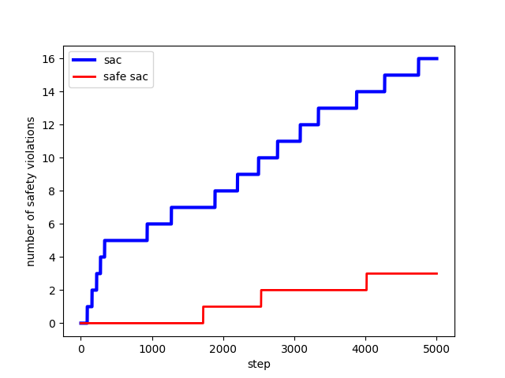
Implementation – Case One with Simple Environment
Case One: Results
Many safety violations at the initial training stage without the Safety Layer
Zero safety violations at the initial training stage with the Safety Layer
Positive lambda’s at the beginning shows the effect of the Safety Layer
Discounted reward Number of Safety Violations Value of Lambda

Slide 10
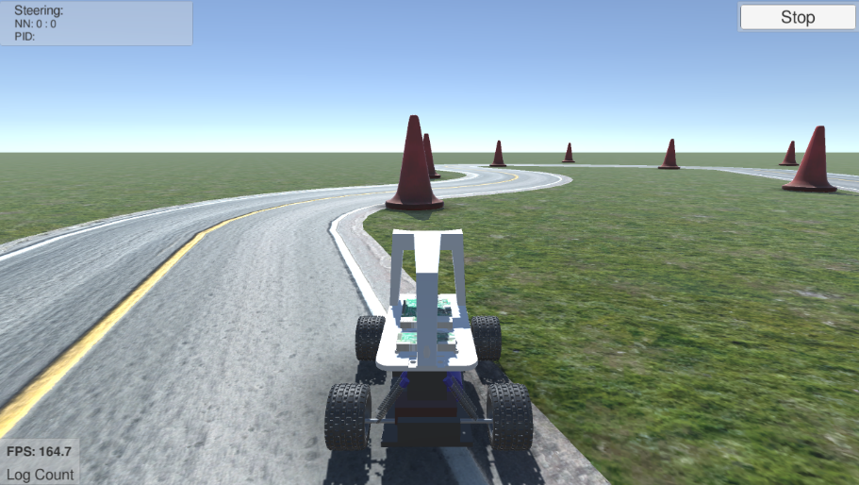

Implementation – Case Two with Complex Environment
Case Two: Complex Environment
Many continuous sharp turns with almost no straight lanes
Safety related information collected by random sampling and running well trained model
The linearly approximated safety layer trained with two fully connected layers, with 64 and 16 neurons respectively
Lane Environment Front Camera Image

Slide 11
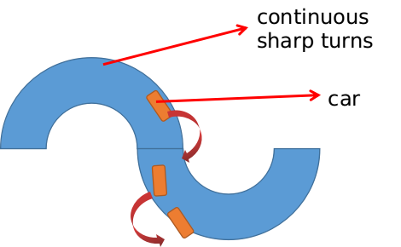
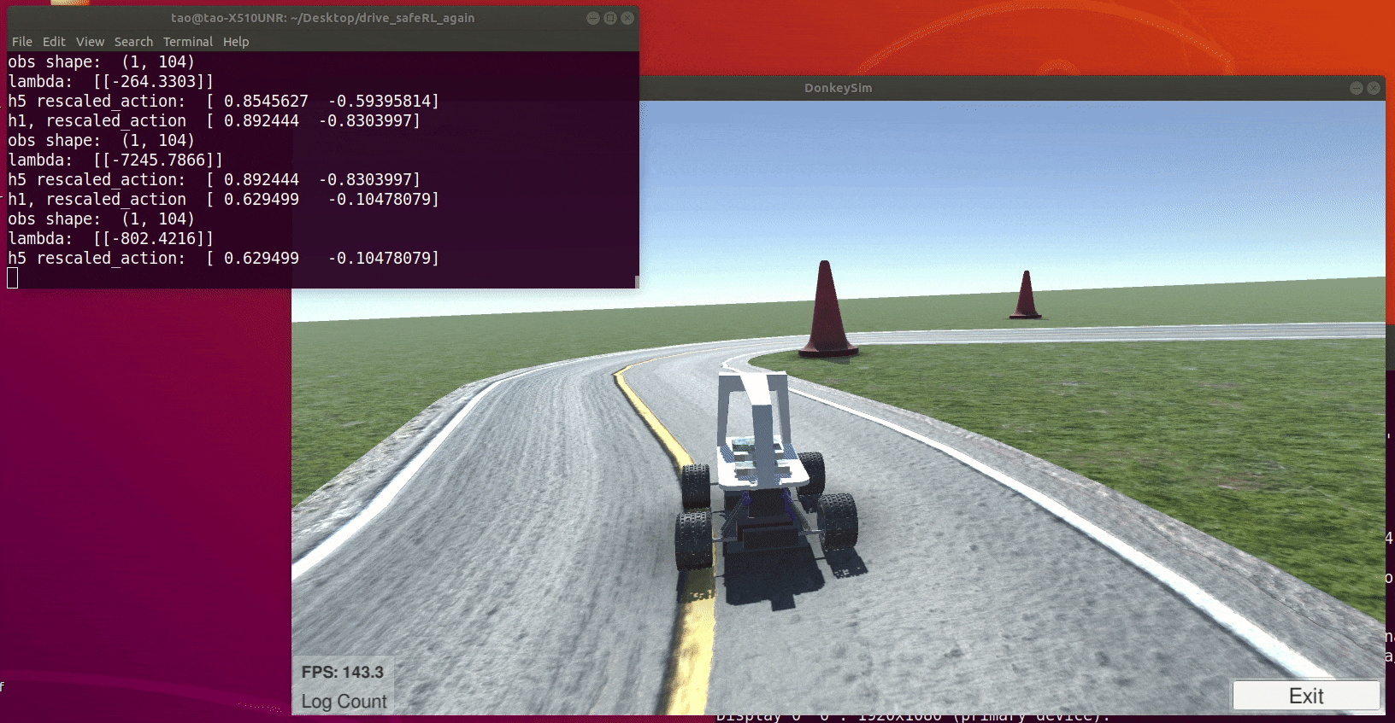
Implementation – Case Two with Complex Environment
Case Two: Results – Gif Image
The Safety-Layer push back is not enough for the car to go through the sharp turn
With Safety Layer Sharp Turn Schematic

Slide 12
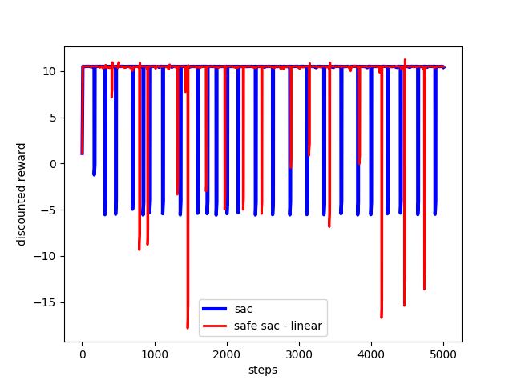
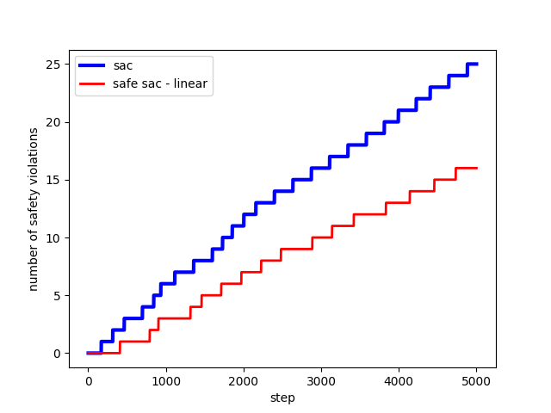
Implementation – Case Two with Complex Environment
Case Two: Results
The training process with Safety Layer still has many safety violations, although slightly fewer than the case without Safety Layer
Discounted reward Number of Safety Violations

Slide 13
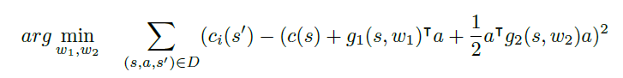
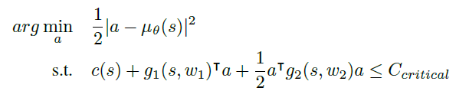
Implementation – Case Two with Complex Environment
Higher order approximation might be needed for complex Environment
Quadratic approximation to describe the safety signal with neural networks
Revise the proposed action: quadratically constraint quadratic programming (QCQP)
No close form solution available for QCQP
Use suggest-and-improve heuristics to solve approximately [Park & Boyd, 2017]
When the problem is not solvable, use the originally proposed action

Slide 14
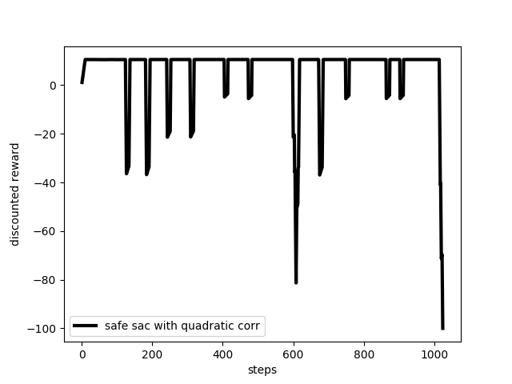
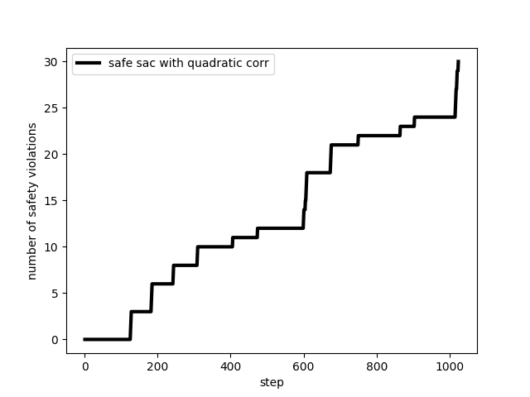
Implementation – Case Two with Complex Environment
Case Two: Results with quadratic approximation for safety signal
The quadratic approximation gives even worse results concerning safety violations
Possibly caused by QCQP not always solvable
Discounted reward Number of Safety Violations

Slide 15
Summary
Implemented the Safety Layer approach to ensure safety for reinforcement learning applied to autonomous drive
Linear approximated safety layer works to some extent for simple environment
Linear approximated safety layer does not work well for complex environment
Quadratic approximated safety layer is proposed, and works badly for complex environment
Things to be considered for safe reinforcement learning with autonomous drive
Concerning safety layer approach, it is necessary to collect safety signal data representatively and comprehensively
More effort should be put into reinforcement learning algorithms, such as reward function design, policy optimization and so on

